Slide 1
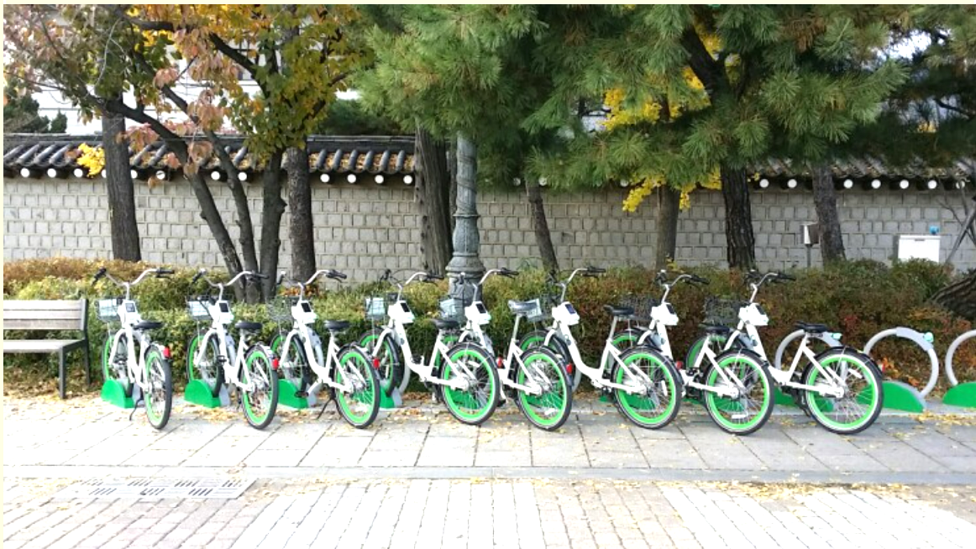
Seoul Bike Sharing
Midterm Presentation for 2023 Spring Cloud Computing
Kyuri Kim, HaeLee Kim, Nayaeun Kwon

Slide 2
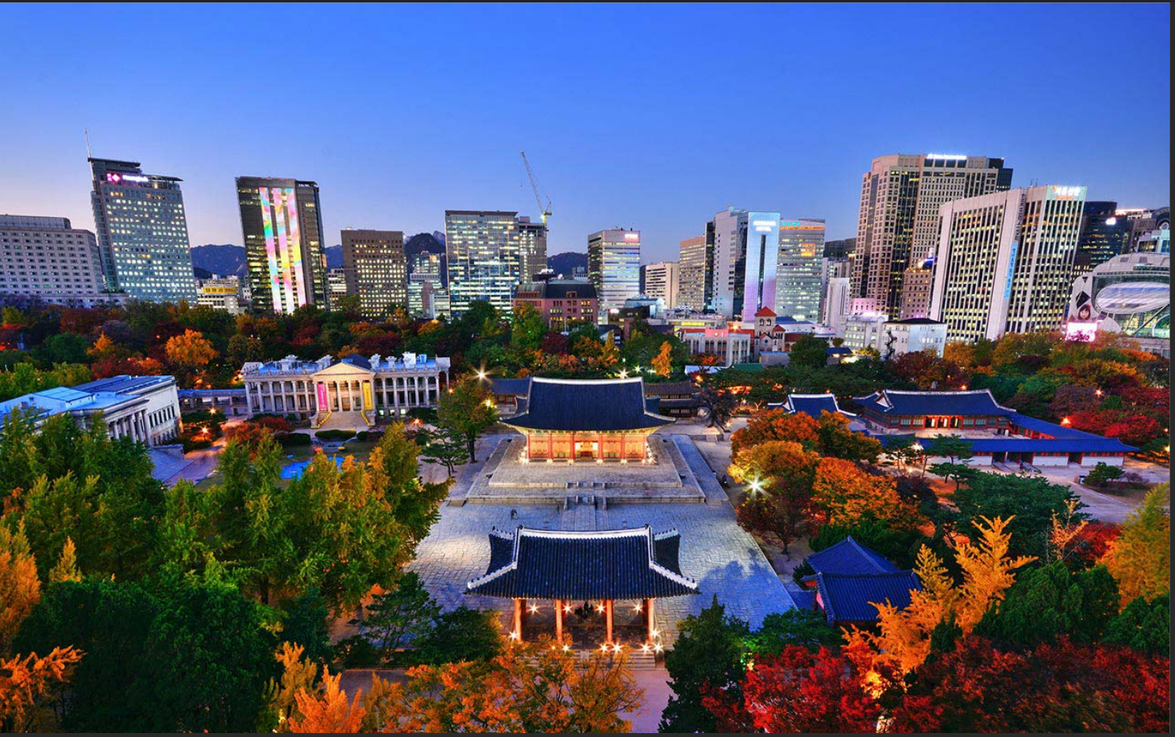
SEOUL
A Complete Guide to Attractions in Seoul | The Official Travel Guide to Seoul (visitseoul.net)
is the capital city of South Korea
with a population of over 10 million people
having a rich history dating back over 2000 years
but also known for cutting-edge technology
full with fascinating cultural attractions.

Slide 3
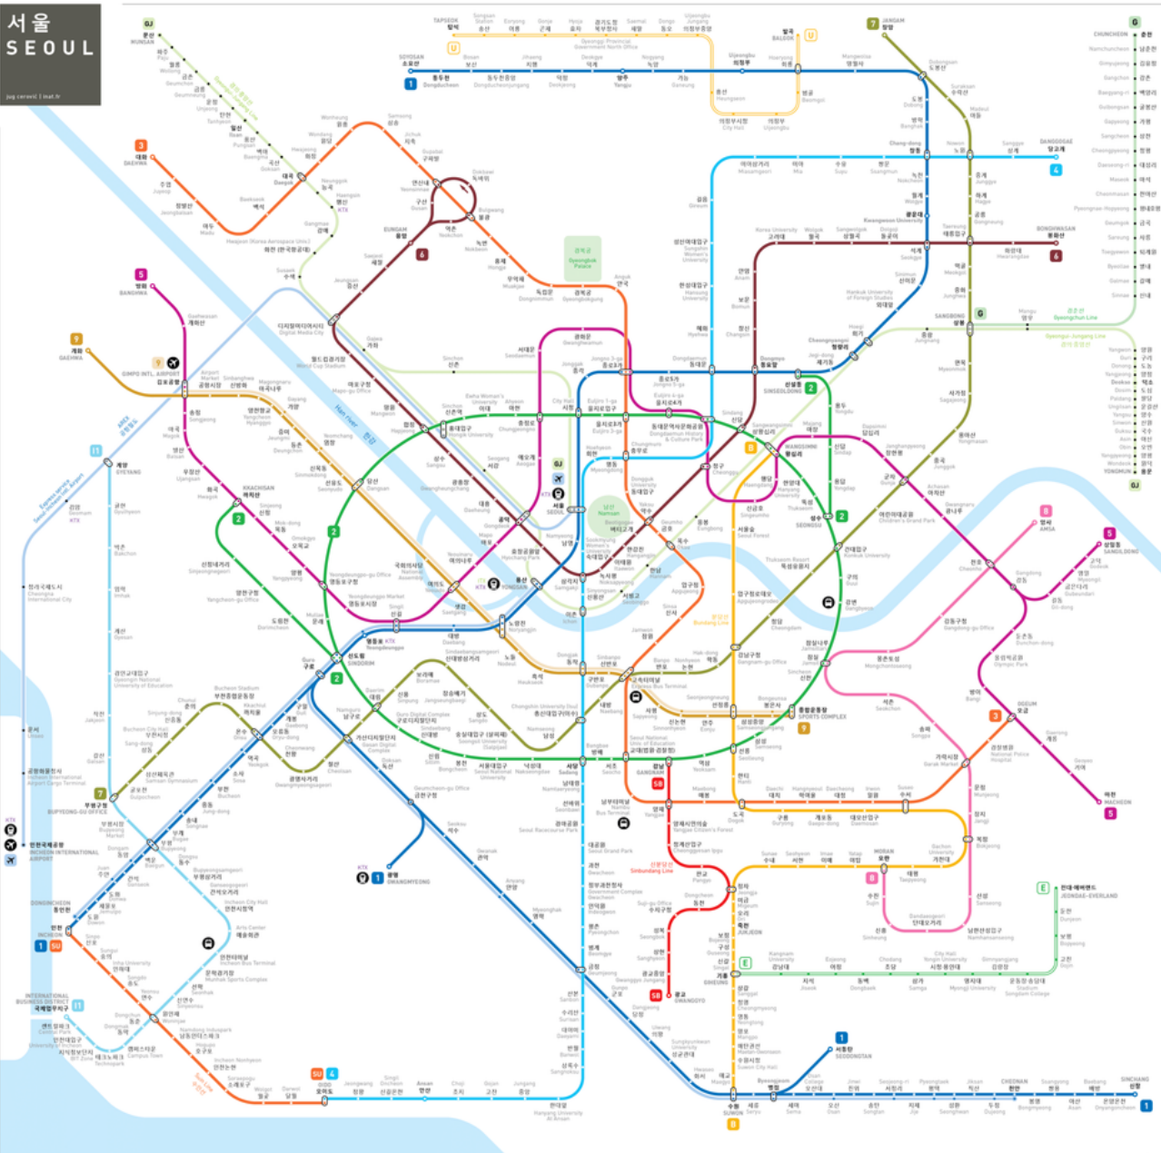
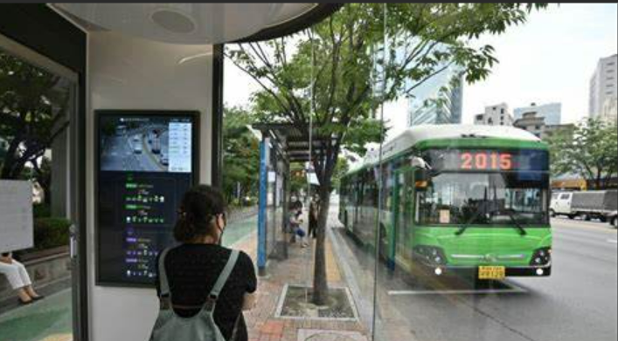
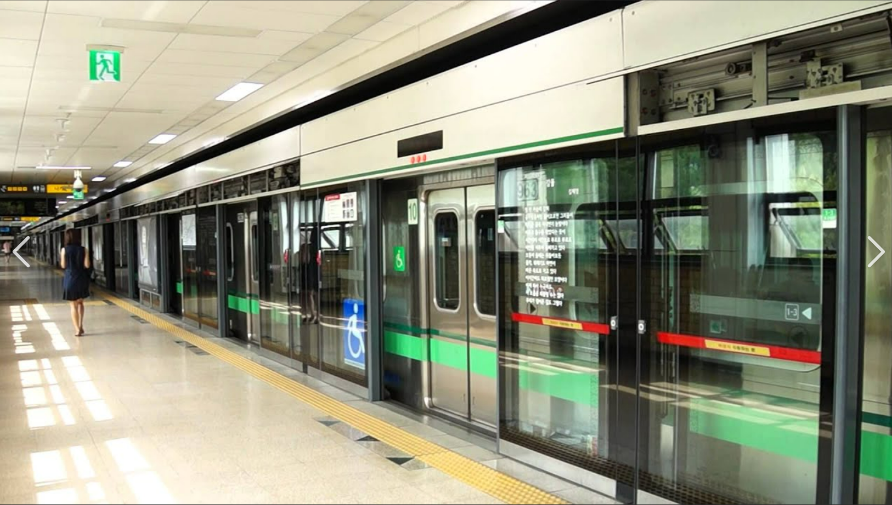
You can go anywhere in Seoul with the public transportation system.

Slide 4
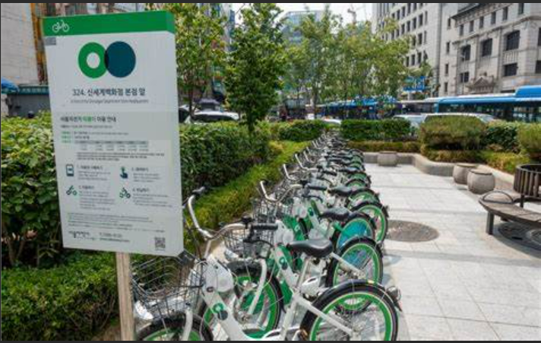
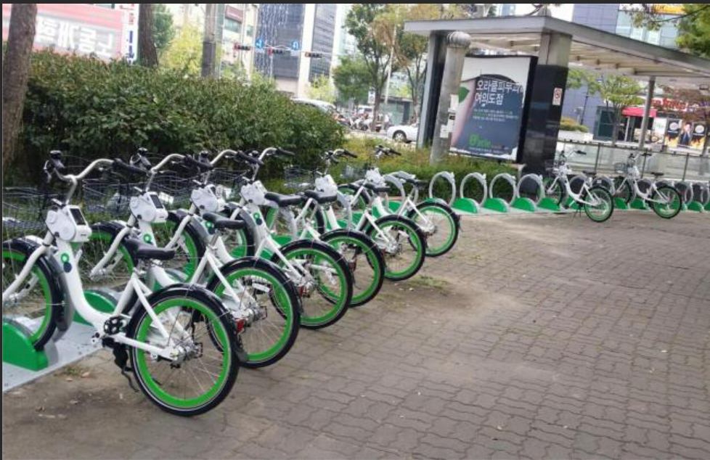
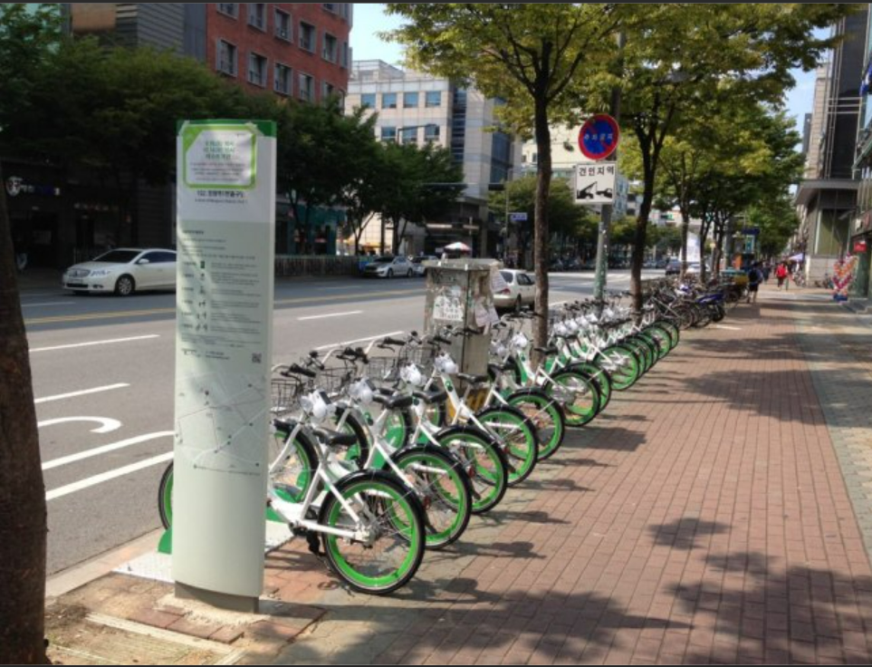
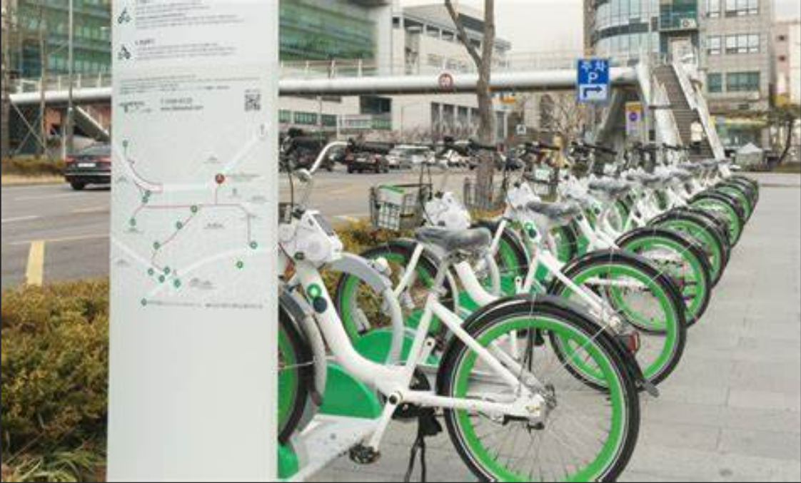
Bike Sharing System in Seoul bikeseoul.com
city government system
20,000+ bikes
24/7 operation
stations strategically located
web/mobile registration
GPS tracking

Slide 5
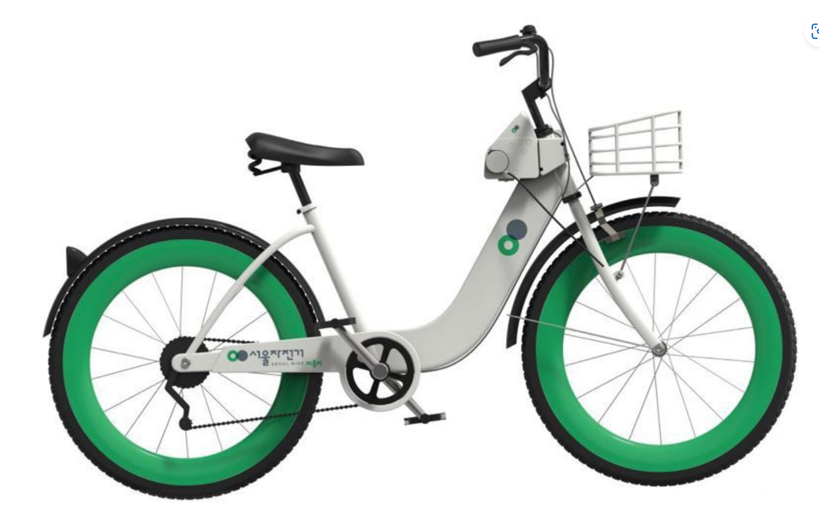
Project Introduction
o Rental bikes are introduced in Seoul for the enhancement of mobility comfort.
o It is important to make the rental bike available and accessible to the public
at the right time as it lessens the waiting time.
o Providing the city with a stable supply of rental bikes becomes a major concern.
o The dataset contains weather information & the number of bikes rented
per hour and date information.

Slide 6
Dataset Information
Number of Instances : 8760
Number of Features : 14
Types of Features : Integer, Float, and Character
Date Range : 12/1/2017 - 11/30/2018
Date Donated : 3/1/2020
Data Source URL: https://archive.ics.uci.edu/ml/datasets/Seoul+Bike+Sharing+Demand#
Original Datasets URL: http://data.seoul.go.kr/ and publicholidays.go.kr

Slide 7
The Implemented Features
Date : year-month-day
Hour : Hour of the day
Rented Bike count : Count of bikes rented at each hour
Temperature : Temperature in Celsius
Humidity : %
Windspeed : m/s
Visibility : 10m
Dew point temperature : Celsius
Solar radiation : MJ/m2
Rainfall : mm
Snowfall : cm
Seasons : Winter, Spring, Summer, Autumn
Holiday : Holiday / No holiday
Functional Day : NoFunc (Non Functional Hours), Fun (Functional hours)

Slide 8
Expected Outcomes
Goal
Predict the bike count required at each hour and season for the stable supply of rental bikes
Target
Rented bike count
Hypothesis 1
During rush hours, the bike rental count will be higher compared to non-rush hours.
Hypothesis 2
Bike rental count will decrease when the temperature drops below 0°C (32°F) or rises above 30°C (86°F).
ML Models
Regression Analysis, Time Series Analysis, Decision Tree Analysis

Slide 9
Logical architecture of AWS cloud services
AWS cloud services to be used are VPC & EC2.
Logical architecture
Create a VPC - Public Subnet
Launch EC2
Set up Git Repository
Collaborate on the code
Run the ML models
* Optional steps: Create individual IAM users and S3/EBS

Slide 10
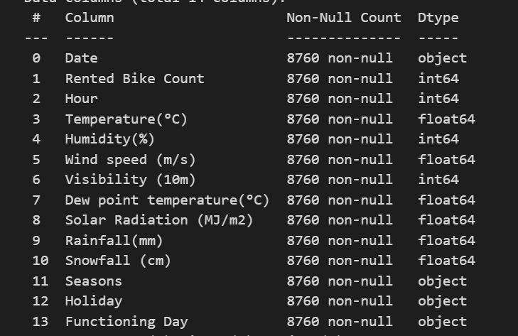
The Data Flow
To prepare EDA and ML analysis,
Data will be cleaned up / processed by
o dropping nulls and outliers
o converting Seasons into factor
(Spring : 1, Summer : 2, Fall : 3, Winter : 4)
o & Holiday and Functioning Day into binary
(Holiday : 0, No Holiday 1)
(Functional Day : 0. No Functional Day : 1)

Slide 11
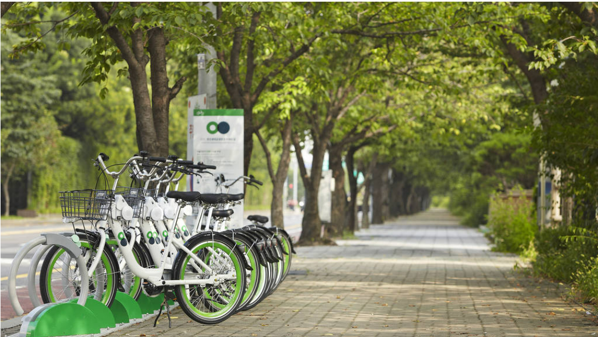
Thank you!

